Slide 1
Unit3: Syntactic Specification of Languages
Formal description of programming languages

Slide 2
BNF
Formal, mathematical way to specify context-free grammars
Precise and unambiguous
Before BNF, people specified programming languages ambiguously, (with english)

Slide 3
BNF
BNF is not technically a “normal form”; this would imply that there would be only one correct way of writing a grammar
We use arithmetic expressions as an example.

Slide 4
BNF
<expression> ::= <term> | <term> "+" <expression>
<term> ::= <factor> | <factor> "*" <term>
<factor> ::= <constant> | <variable> | "(" <expression> ")"
<variable> ::= "x" | "y" | "z"
<constant> ::= <digit> | <digit> <constant>
<digit> ::= "0" | "1" | "2" | "3" | "4" | "5" | "6" | "7" | "8" | "9"

Slide 5
EBNF
The syntax of a language is its grammatical rules.
These are usually defined through EBNF(Extended Backus-Naur Form)and/or syntax diagrams

Slide 6
EBNF
This grammar can also be expressed in EBNF (Extended BNF) which improves readability and writability of BNF.

Slide 7
EBNF
expression = term , {"+" term};
term = factor , {"*" factor};
factor = constant | variable | "(" , expression , ")";
variable = "x" | "y" | "z";
constant = digit , {digit};
digit = "0" | "1" | "2" | "3" | "4" | "5" | "6" | "7" | "8" | "9";

Slide 8
Syntax diagrams
Aka railroad diagrams represent a graphical alternative to BNF or to EBNF
Railroad diagrams are visual, and may be more readily understood by people, sometimes incorporated into graphic design.

Slide 9
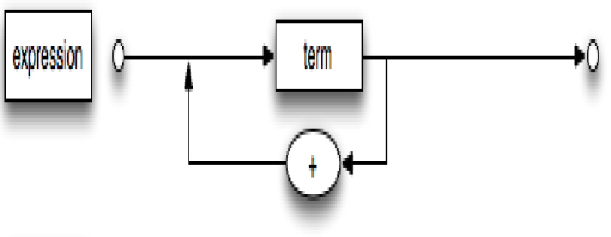
Syntax diagrams

Slide 10
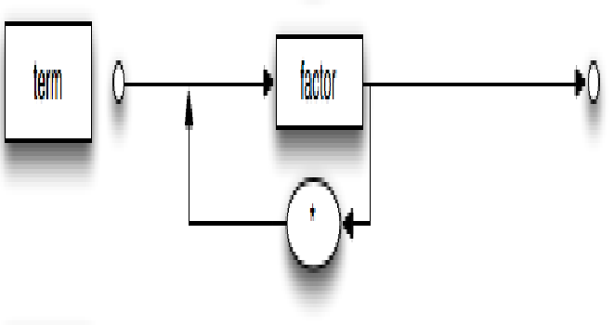
Syntax diagrams

Slide 11
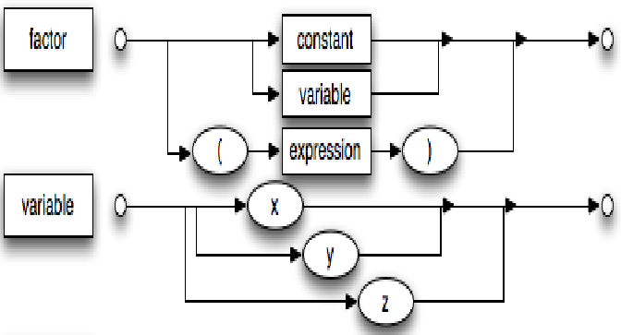
Syntax diagrams

Slide 12
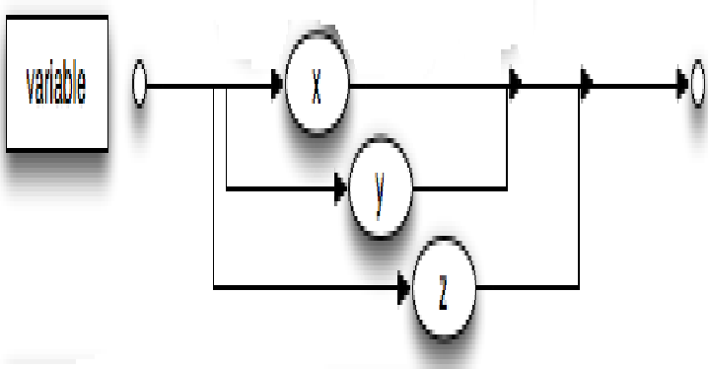
Syntax diagrams

Slide 13
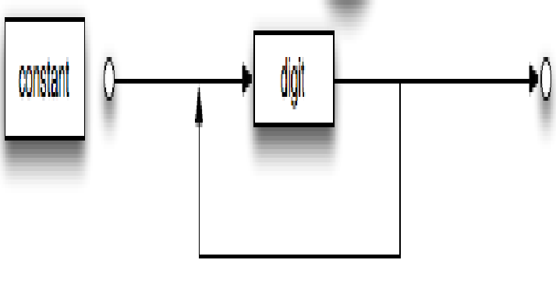
Syntax diagrams

Slide 14
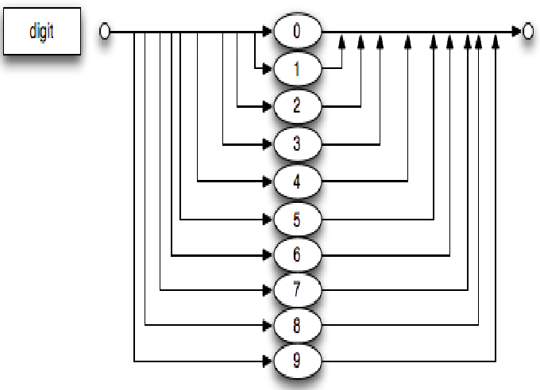
Syntax diagrams

Slide 15
BNF
Provides a clear and concise syntax description.
The parser can be based directly on the BNF
Parsers based on BNF are easy to maintain
BNF is a metalanguage used to describe the grammar of a programming language
BNF is formal and precise
BNF is essential in compiler construction

Slide 16
BNF
BNF is a metalanguage used to describe other languages.
In BNF, abstractions are used to represent classes of syntactic structures--they act like syntactic variables.

Slide 17
Formal description of PL’s
A description of a programming language is called formal when it is expressed entirely in a mathematically well-defined notation: in a programming language description language.
Formal descriptions are highly desirable, in particular since they can be checked for both precision and completeness.

Slide 18
Context-Free Grammar
Consists of a series of grammar rules.
Each rule has a single phrase structure name on the left, then a → metasymbol, followed by a sequence of symbols or other phrase structure names on the right.

Slide 19
Terminals
Atomic components of statements in the language.
Appear in source programs: identifiers, operators, punctuation, keywords.
Words or token symbols that cannot be broken down further.

Slide 20
Productions
Another name for grammar rules.
Typically there are as many productions in a context-free grammar as there are non-terminals.

Slide 21
Terminology(Cont.)
Start (or goal) symbol: a nonterminal representing the entire top-level phrase being defined.
Context-free language (CFL): if all of its strings are generated by a context-free grammar.
Symbol table
An environment that stores information about identifiers
A data structure that captures scope information
Each entry in symbol table contains
The name of an identifier
Its kind (variable/method/field…)
Type
Additional properties, e.g., final, public (not needed for IC)
One symbol table for each scope

Slide 22
Example CFG
<sentence> –> <noun-phrase> <verb-phrase> (1)
<noun-phrase> –> <proper-noun> (2)
<noun-phrase> –> <determiner> <common-noun> (3)
<proper-noun> –> John (4)
<proper-noun> –> Jill (5)
<common-noun> –> car (6)
<common-noun> –> hamburger (7)

Slide 23
Example CFG (Cont.)
<determiner> –> a (8)
<determiner> –> the (9)
<verb-phrase> –> <verb> <adverb> (10)
<verb-phrase> –> <verb> (11)
<verb> –> drives (12)
<verb> –> eats (13)
<adverb> –> slowly (14)
<adverb> –> frequently (15)

Slide 24
Example Derivation
<sentence> => <noun-phrase> <verb-phrase> by (1)
=> <proper-noun> <verb-phrase> by (2)
=> Jill <verb-phrase> by (5)
=> Jill <verb> <adverb> by (10)
=> Jill drives <adverb> by (12)
=> Jill drives frequently by (15)

Slide 25
Informally, a CFG consists of
A set of replacement rules, each having a Left-Hand Side (LHS) and a Right-Hand Side (RHS).
Two types of symbols; variables and terminals.
LHS of each rule is a single variable (no terminals).
RHS of each rule is a string of zero or more variables and terminals.
A string consists of only terminals.

